Slide 1
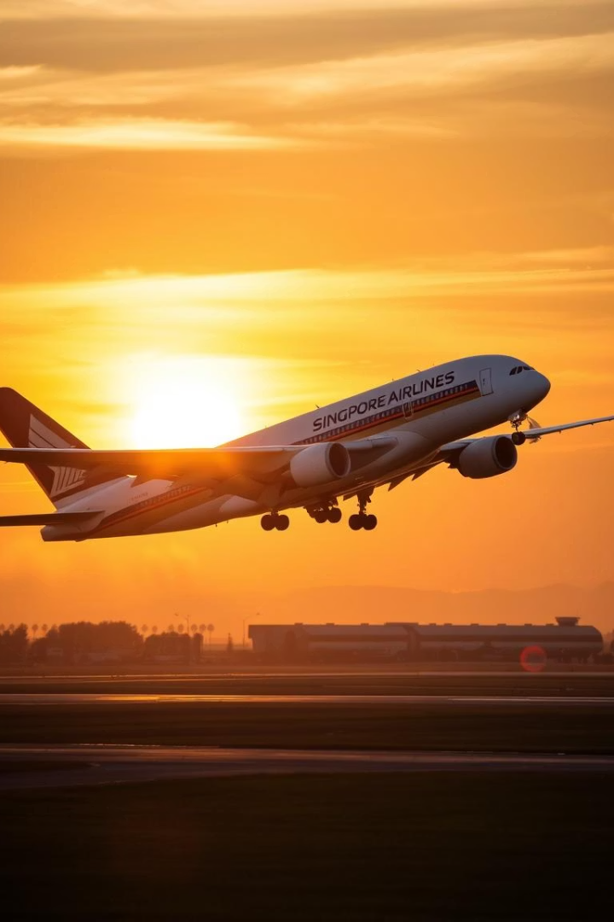
Singapore Airlines: Regaining Customer Satisfaction
In-depth analysis of customer reviews from 2018-2024.
Insights and recommendations to enhance brand image and customer trust.
Duong Hoang Lai
April, 2025

Slide 2

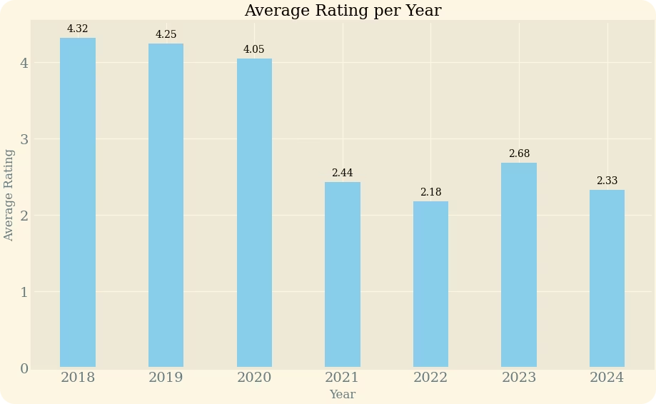
Identifying the Turbulence
Customer ratings sharply declined in 2021. The volume of low ratings surpassed positive reviews. This highlights critical issues affecting customer satisfaction.
Declining Ratings
Sharp drop in customer ratings after Covid-19 pandemic
Negative Reviews
While there are still high ratings for airlines overall services, low ratings outnumber positive ones.

Slide 3

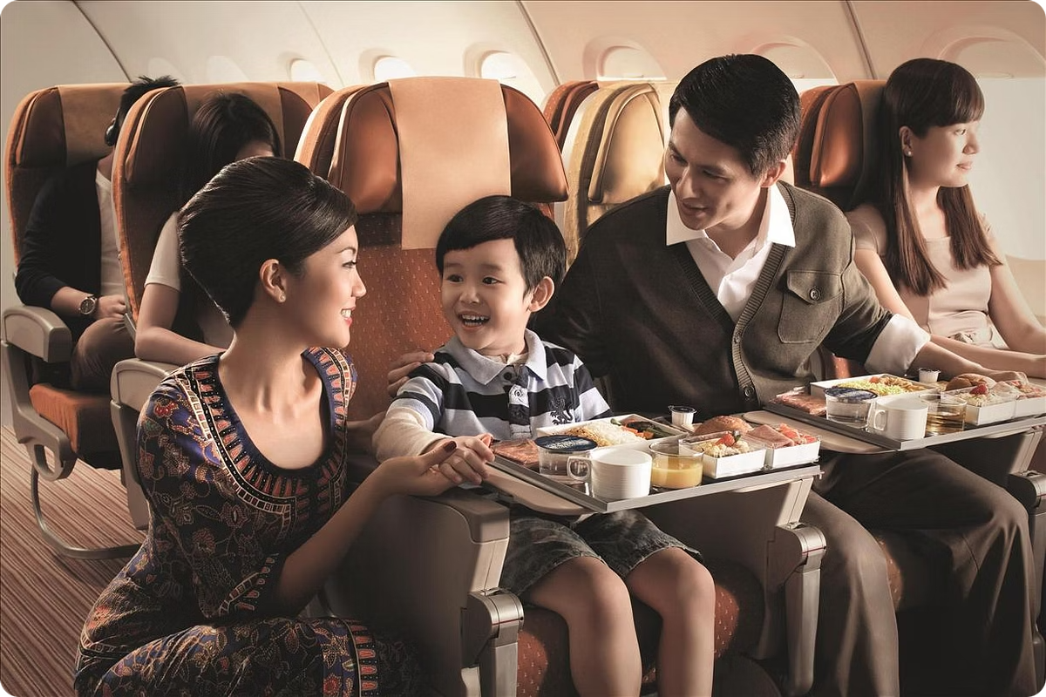
Golden Age (Before 2021)
High ratings for in-flight amenities. Customers loved the comfortable seats and delicious meals. Hospitable cabin crew contributed to positive experiences.
In-Flight Excellence
Positive Experiences
Comfortable seats
Amazing pre-departure service
Delicious meals
Hospitable crew
Nice lounges
Responsive support

Slide 4





Turbulent Times (After 2021)
Customer satisfaction plummeted, especially in service. Strengths became points of complaints. Loyal customers are leaving the airline.
Service Decline
Amenity Issues
Poor customer service and employee attitude.
Small, dirty seats and substandard in-flight services.
Lost Luggage
Ticketing Problems
Increased complaints and lack of support.
Mishandled cancellations and refunds.

Slide 5





Charting a Course Correction
Address fundamental issues to restore service quality. This includes aircraft refurbishment and cabin crew retraining.
Aircraft Refurbishment
Revamp aircraft interiors.
Enhanced Cleaning
Establish strict pre-departure cleaning procedure
Catering Revision
Revise catering partnerships.
Crew Retraining
Launch new rigorous cabin crew training program

Slide 6
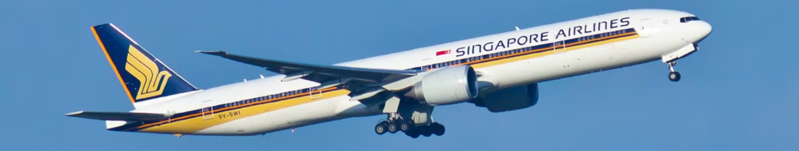




Regaining Altitude
Repair operational blind spots and regain customer trust.
Website Fixes
Partner Alignment
Luggage Solutions
Customer Trust
Revamp Singapore Airline's website and encourage customer direct booking.
Establish direct feedback channel for customer.
Ensure ticket information are aligned across all booking and airline partner.
Strengthen partnership with ground services provider.

